Slide 1
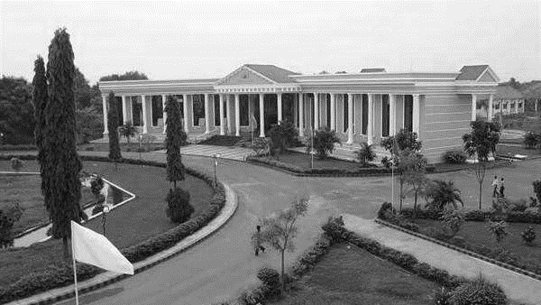



BLOCK CHAIN INSPIRED SECURE COMPUTATION OFFLOADING IN A VEHICULAR CLOUD NETWORK
Presented By:
SANTHOSH.V 510419104060
VASEEGARAN.C 510419104076
VISHVAA S.V. 510419104079
VIJIPRAKASHRAJ.P 510419104077
Supervisor:
Dr.S.MOHANARANGAN,Ph.D
AP/CSE
DEPARTMENT OF
CSE

Slide 2
ABSTRACT
In this project a blockchain based secure computation offloading scheduling scheme is proposed. It embraces the Blockchain based trust management paradigm and smart contract enabled Deep Reinforcement Learning (DRL) algorithm.
Specifically, a novel three-valued subjective logic (3VSL) scheme is adopted to obtain a more comprehensive reputation, and the statistics of behavioral transitions can provide a shortterm trust variability to timely capture the malicious behaviors.

Slide 3
INTRODUCTION
BlockChain Inspired Secure Computation Offloading in a Vehicular Cloud Network is a research project that aims to develop a secure computation offloading system for vehicular cloud networks using blockchain technology.
Vehicular cloud networks are an emerging technology that allows vehicles to communicate with each other and with infrastructure to share information, such as traffic data or road conditions, and to offload computation tasks to cloud servers.

Slide 4
LITERATURE SURVEY
SURVEY PAPER | AUTHOR | MERITS AND DEMERITS
1. SECURE COMPUTATION OFFLOADING IN BLOCK CHAIN BASED IOT NETWORKS WITH DEEP REINFORCEMENT LEARNING | Dinh C. Nguyen, Pubudu N. Pathirana, Ming Ding, Aruna Seneviratne | Merits: To generate and broadcast messages in order to improve traffic safety and efficiency. Demerits: privacy preservation is an open problem
2. SECURE COMPUTATION OFFLOADING IN BLOCK CHAIN BASED IOT NETWORKS WITH DEEP REINFORCEMENT LEARNING | Huned Materwala , Leila Ismail , Raed M. Shubair , Rajkumar Buyya | Merits: We adopt 3VSL propose a holistic solution to trust assessment in vehicular social networks Demerits: To improve the system performance, and technique to support intra- and inter-community trust assessment

Slide 5
OBJECTIVE
Blockchain-based Consensus: Ensures that computations are verified by multiple nodes and prevents unauthorized tampering.
Secure Data Offloading: Encryption techniques, such as homo morphic encryption or zero-knowledge proofs, can be employed to ensure that data remains confidential
Smart Contracts: These contracts can specify the computation tasks, data requirements, payment mechanisms. Smart contracts ensure that both the vehicles and cloud servers

Slide 6
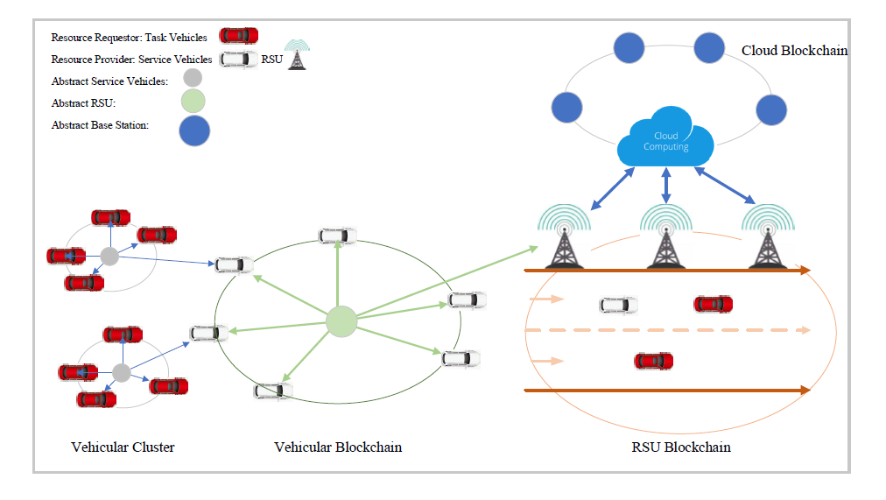
ARCHITECTURE DIAGRAM

Slide 7
EXISTING SYSTEM
Previously the computing informations are stored in road side unit and cloud networks
It has more vulnerability for security and it has lot of implementation and scalability limitations
We are storing the computing information securely in the cloud network using blockchain

Slide 8
DRAWBACKS
Performance overhead
Scalability limitations
Security vulnerabilities
Implementation complexity

Slide 9
PROSPOSED SYSTEM
The proposed system uses smart contracts, which are self-executing contracts with the terms of the agreement between client and service provider being directly written into lines of code, to manage the computation offloading process.
The system also uses a consensus mechanism to ensure that the smart contracts are executed correctly and that the results of the computation are accurate.
The system is designed to be secure and efficient, allowing vehicles to offload computation tasks to the cloud with confidence that their data and computation will remain secure.

Slide 10
MODULE
STORAGE MANAGEMENT
Storing the computing information in the cloud.
SECURITY MANAGEMENT
Blockchain based secure computation offloading scheduling scheme is proposed for security.
DISTRIBUTION MANAGEMENT
Heterogeneous resource distribution in a Vehicular Cloud Network(VCN).
CONGESTION MANAGEMENT
We are overcoming the problem of congestion of vehicular cloud information

Slide 11
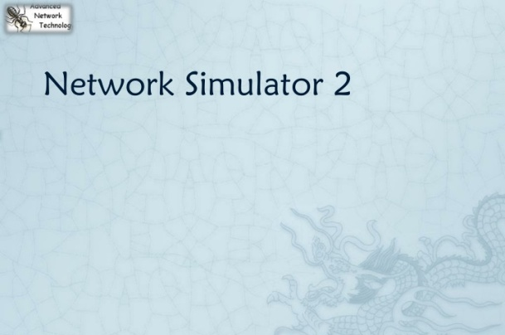
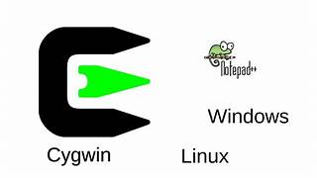
PRE REQUISITE
HARDWARE REQUIREMENTS
Processor - Pentium –III
Speed - 1.1 GHz
RAM - 256 MB (min)
Hard Disk - 20 GB
Floppy Drive - 1.44 MB
Key Board - Standard Windows
Mouse - Two or Three Button
Monitor - SVGA
SOFTWARE REQUIREMENTS
Operating System : Windows XP
Tool : Network Simulator-2
3. Front End : CYGWIN

Slide 12
VMWARE
A virtual machine (VM) is the base unit of VMware virtualization. A VM is a software-based representation of a physical computer. An operating system (OS) running in a VM is called a guest OS.
Using VMware products and services for virtualization brings several benefits.

Slide 13
NETWORK SIMULATOR (NS2)
NS2 stands for Network Simulator Version 2. It is an open-source event-driven simulator designed specifically for research in computer communication networks.
NS2 consists of two key languages: C++ and Object-oriented Tool Command Language (OTcl). While the C++ defines the internal mechanism (i.e., a backend) of the simulation objects, the OTcl sets up simulation by assembling and configuring the objects as well as scheduling discrete events. The C++ and the OTcl are linked together using TclCL

Slide 14
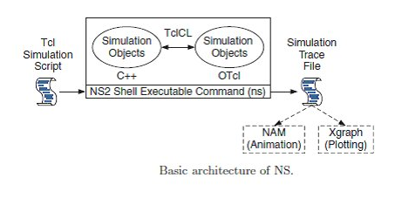
BASIC ARCHITECTURE OF NS2

Slide 15
FUNCTIONALITIES OF NS2
Support for the wired world include
Routing DV, LS, and PIM-SM.
Different types of Queues: drop-tail, RED, FQ, SFQ, DRR.
Support for the wireless world include
Ad hoc routing with different protocols, e.g. AODV, DSR, DSDV, TORA
Satellite
Visualization
Network Animator (NAM)
Trace Graph

Slide 16
OTcL AND C++: THE DUALITY

Slide 17
vCENTRE
VCenter Server has three main components:
1) VSphere Web Client is the platform's user-interface, providing administrators with browser-based access to all functions
2) VCenter Server Database is the data repository for the product. It stores data necessary for server hosts to run hypervisors and virtual machines
3) VCenter Single Sign-On lets you access the entire vSphere infrastructure with a single login.

Slide 18
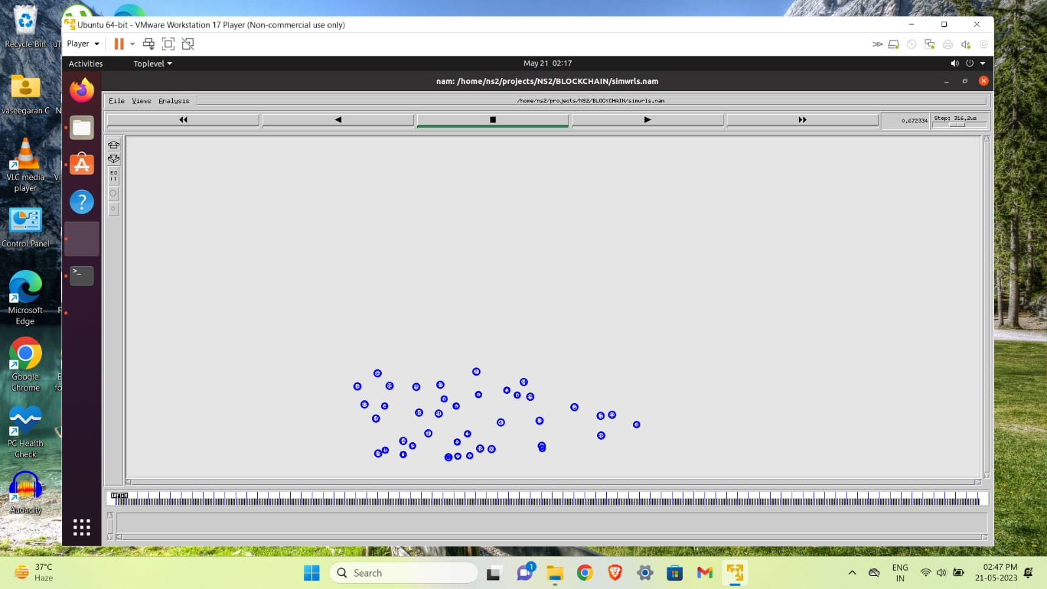

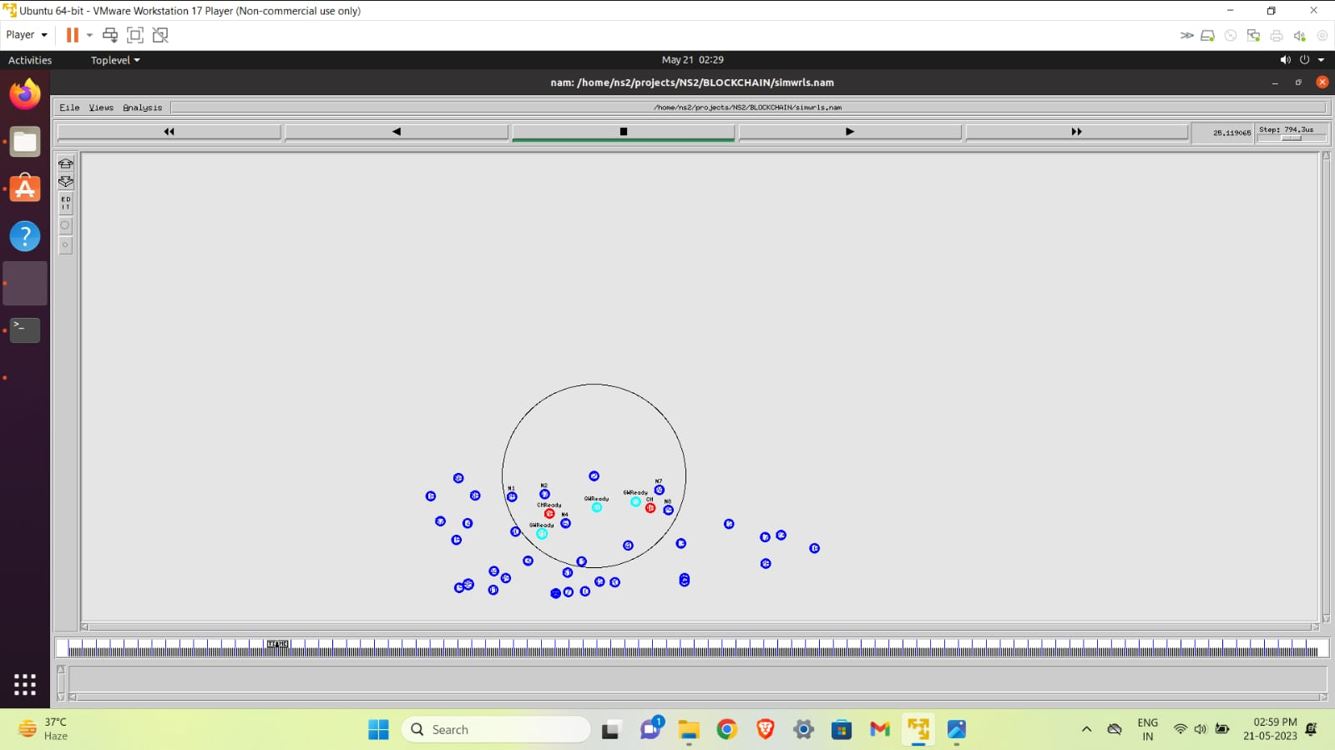
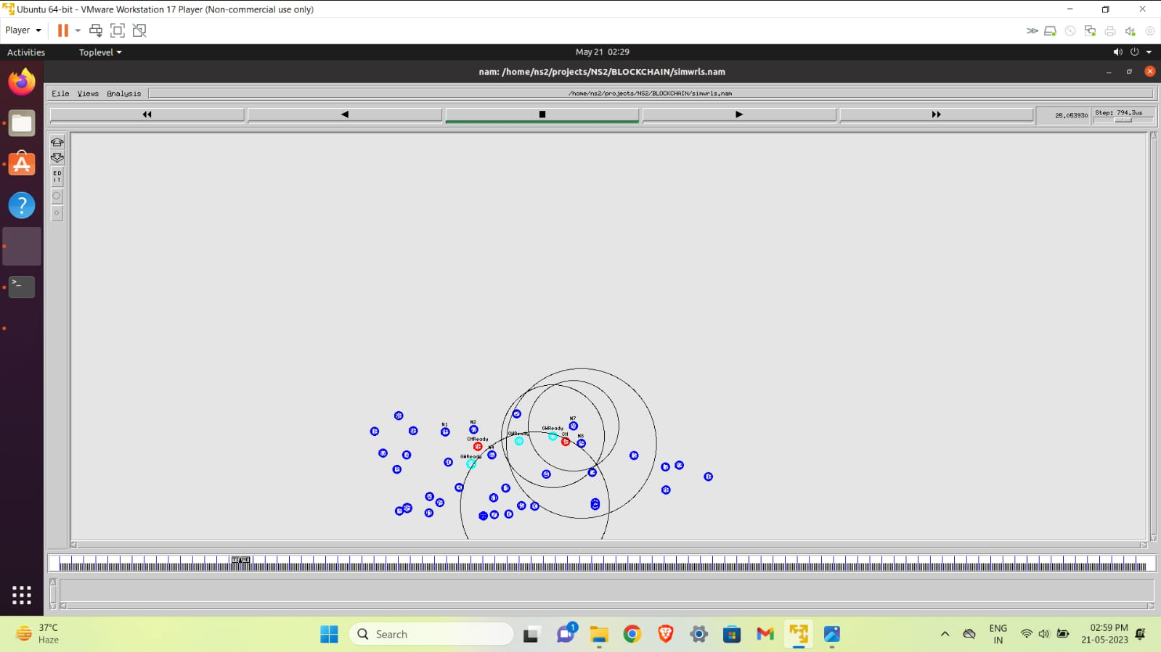
IMPLEMENTATION SOURCE CODE
1.NODES ARE ACTIVE TO COMPUTATION 2. CLOUD GATHERING DATA FROM NODES
3.BLOCKCAHIN CAN ACTIVE IN ALL NODE 4.ALL NODES ARE
SHARING DATA AT OFFLOADING COMPUTATION

Slide 19
DEMO VIDEO

Slide 20
CONCLUSION
In this work, we proposed a blockchain based secure computation offloading scheme in a vehicular cloud network, which comprises the blockchain based trust management and DRL algorithm based smart contract.
The advantages and challenges of the proposed secure computation offloading scheme are discussed from multiple perspectives.
Extensive simulation experiments are conducted to verify the effectiveness of the proposed scheme

Slide 21
REFERENCE
Z. Yang, K. Yang, L. Lei, K. Zheng, and V. C. Leung, “Blockchain-based decentralized trust management in vehicular networks,” IEEE Internet of Things Journal, vol. 6, no. 2, pp. 1495–1505, 2018.
Y. Dai, D. Xu, S. Maharjan, Z. Chen, Q. He, and Y. Zhang, “Blockchain and deep reinforcement learning empowered intelligent 5g beyond,” IEEE Network, vol. 33, no. 3, pp. 10–17, 2019.
T. Cheng, G. Liu, Q. Yang, and J. Sun, “Trust assessment in vehicular social network based on three-valued subjective logic,” IEEE Transactions on Multimedia, vol. 21, no. 3, pp. 652–663, 2019.

Slide 22
THANK YOU
DEPARTMENT OF
CSE

